Slide 1







Welcomes
12 programmes accredited
Ranked 501-600 in Rankings 2025
Ranked 801-850 in
World Rankings 2025
Ranked 46th in
Rankings 2024*
A Grade
* University Category

Slide 2
Stack Organization

Slide 3
Stack is also known as the Last In First Out (LIFO) list. It is the most important feature in the CPU. It saves data such that the element stored last is retrieved first.
A stack is a memory unit with an address register. This register influence the address for the stack, which is known as Stack Pointer (SP).
The stack pointer continually influences the address of the element that is located at the top of the stack.
The insertion operation is known as push operation and the deletion operation is known as pop operation.
In a computer stack, these operations are simulated by incrementing or decrementing the SP register.

Slide 4
Advantages of Stack Organization in Computer Architecture
There are several advantages to using stack organization in computer architecture:
Stacks are used to manage function calls and recursion in programming languages. Stacks help in organizing memory efficiently by allocating space for variables in a structured way.
The operations on a stack are straightforward and fast, making it ideal for managing temporary data.
Stacks are essential in algorithms that require backtracking, such as depth-first search (DFS) in graph traversal.
Efficient computation of complex arithmetic expressions.

Slide 5
Disadvantages of Stack Organization in Computer Architecture
There are some disadvantages of using stack organization in computer architecture:
The stack has a fixed size, it can run out of space if too many elements are pushed onto it. This leads to stack overflow errors.
Unlike arrays or other data structures, stacks do not allow random access to elements. Data can only be accessed from the top.

Slide 6
Register Stack
The stack can be arranged as a set of memory words or registers. Consider a 64-word register stack arranged as displayed in the figure.
The stack pointer register includes a binary number, which is the address of the element present at the top of the stack. The three-element A, B, and C are located in the stack.
The element C is at the top of the stack and the stack pointer holds the address of C that is 3. The top element is popped from the stack through reading memory word at address 3 and decrementing the stack pointer by 1.
Then, B is at the top of the stack and the SP holds the address of B that is 2. It can insert a new word, the stack is pushed by incrementing the stack pointer by 1 and inserting a word in that incremented location.

Slide 7
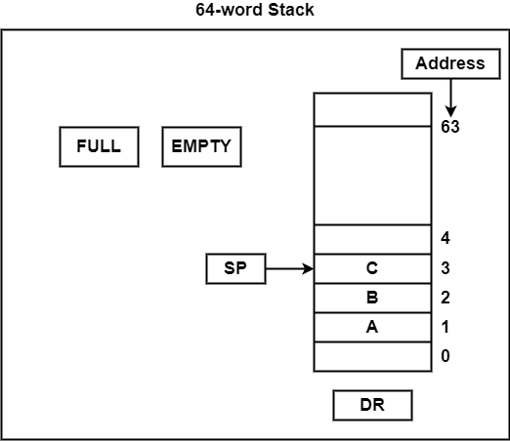

Slide 8
The stack pointer includes 6 bits, because 2⁶ = 64, and the SP cannot exceed 63 (111111 in binary). After all, if 63 is incremented by 1, therefore the result is 0(111111 + 1 = 1000000). SP holds only the six least significant bits. If 000000 is decremented by 1 thus the result is 111111.
Therefore, when the stack is full, the one-bit register ‘FULL’ is set to 1. If the stack is null, then the one-bit register ‘EMTY’ is set to 1. The data register DR holds the binary information which is composed into or readout of the stack.

Slide 9
PUSH Operation
First, the SP is set to 0, EMTY is set to 1, and FULL is set to 0. Now, as the stack is not full (FULL = 0), a new element is inserted using the push operation.
The push operation is executed as follows −
SP←SP + 1 | It can increment stack pointer
K[SP] ← DR | It can write element on top of the stack
If (SP = 0) then (FULL ← 1) | Check if stack is full
EMTY ← 0 | Mark the stack not empty

Slide 10
POP Operation
A new element is deleted from the stack if the stack is not empty (if EMTY = 0). The pop operation includes the following sequence of micro-operations −
DR←K[SP] | It can read an element from the top of the stack
SP ← SP – 1 | It can decrement the stack pointer
If (SP = 0) then (EMTY ← 1) | Check if stack is empty
FULL ← 0 | Mark the stack not full
The top element from the stack is read and transfer to DR and thus the stack pointer is decremented. If the stack pointer reaches 0, then the stack is empty and ‘EMTY’ is set to 1. This is the condition when the element in location 1 is read out and the SP is decremented by 1.

Slide 11
Memory Stack Organization in Computer Architecture
A stack is a storage device in which the information or item stored last is retrieved first. Basically, a computer system follows a memory stack organization, and here we will look at how it works.
A portion of memory is assigned to a stack operation to implement the stack in the CPU. Here the processor register is used as a Stack Pointer (SP). The above figure shows the portion of computer memory divided into three segments: Program Instructions, Data, and Stack.
Program Counter (PC): It is a register that points to the address of the next instruction that is going to be executed in the program.
Address Register (AR): This register points at the collection of data and is used during the execute phase to read an operand.
Stack Pointer (SP): It points at the top of the stack and is used to push or pop the data items in or from the stack.

Slide 12
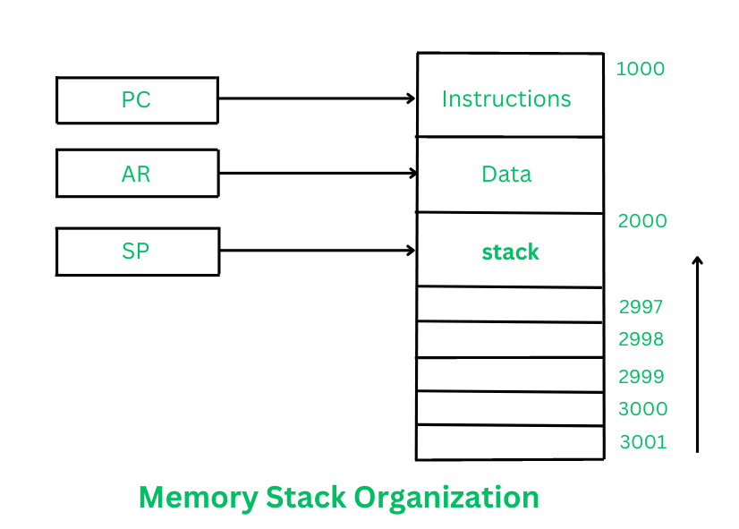

Slide 13
Stack Pointer is first going to point at the address 3001, and then the stack will grow with the decreasing addresses. It means that the first item is going to be stored at address 3001, the second item at address 3000, and the items can keep getting stored in the stack until it reaches the last address 2000 where the last item will be held.
Here the data which is getting inserted into the Stack is obtained from the Data Register and the data retrieved from the Stack is also read by the Data Register.

Slide 14
PUSH and POP operations in Memory stack organization
PUSH
This operation is used to insert a new data item into the top of the Stack. The new item can be inserted as follows:-
SP ←SP-1
M[SP]← DR
In the first step, the Stack Pointer is decremented to point at the address where the data item will be stored.
Then, by using the memory write operation, the data item from Data Register gets inserted into the top of the stack ( at the address where the Stack Pointer is pointing).

Slide 15
POP
This operation is used to delete a data item from the top of the Stack. Data item can be deleted as follows:-
DR←M[SP]
SP←SP+1
In the first step, the top data item is read from the Stack into the Data Register. The Stack Pointer is then incremented to point at the next data item in the stack. Push or Pop operations can be performed with the help of the following microoperations:
Access to memory with the help of Stack Pointer (SP), and
Updating the stack.
It totally depends upon the organization of the stack whether the Stack Pointer (SP) is updated by incrementing or decrementing the address values.

